Slide 1
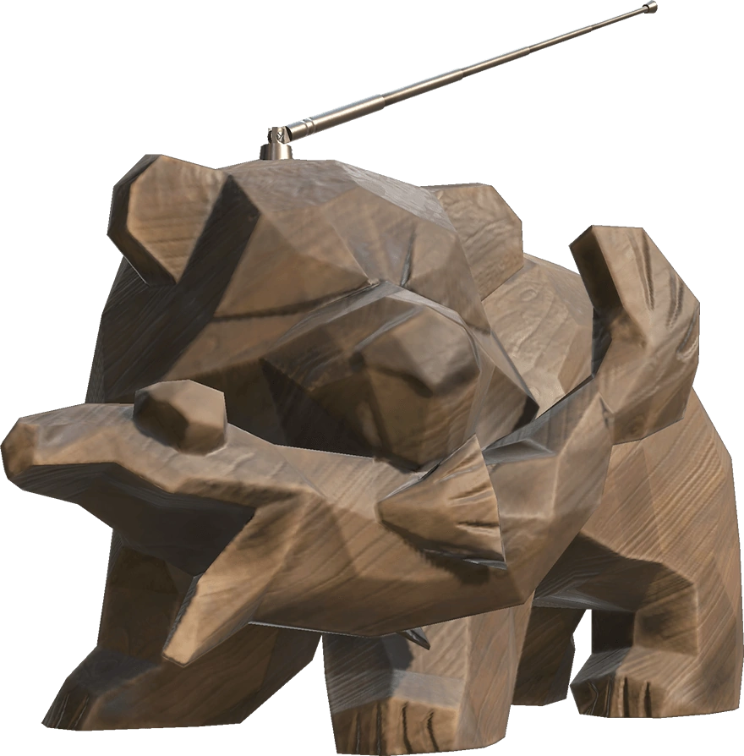
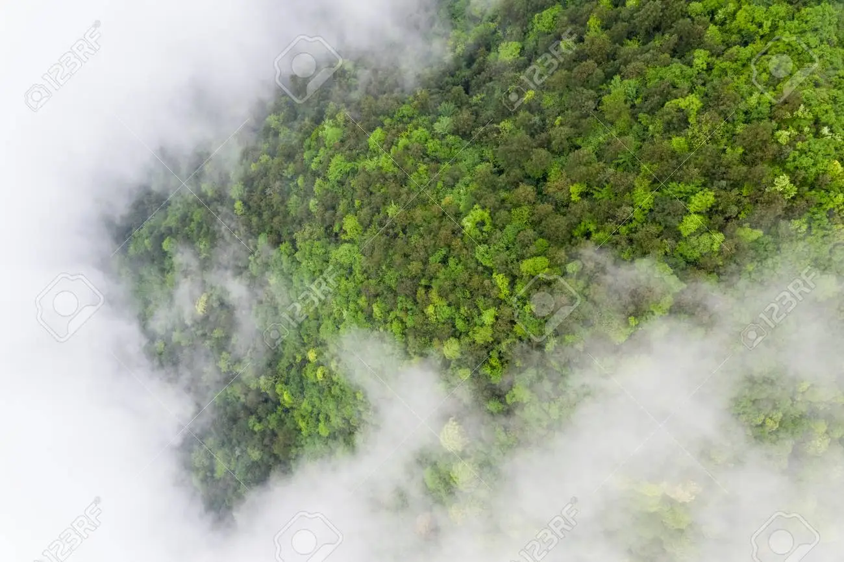
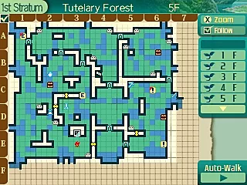

The
“I Think Drawing Maps In Etrian Odyssey Is Really Cool So I Think We Can Make A Game Out Of Literally Just That”
Game
MAKE MORE MAPS!!!
Mountain here and lake here, lemme write that down
you
Okay
50/50 between the levels being hand made or randomly generated

Slide 2
My psychotic ramblings into words that make me sound smart
gameplay loops
Core: Looking at the world and putting what you see on the map
Secondary gameplay loop: finishing the map on time
Tertiary Gameplay loop: Reaching the end of the narrative
Places to expand if i had more manpower
possibly staying fed/paying rent as an additional secondary loop
Random generation so that a high score mode can be added
Deeper narrative and more than like… 2 characters (a cartography office to explore as downtime between maps)
Actual music
If I had:
An artist
The game wouldn’t look like $#!%
A coder
It wouldn’t be poorly optimized
I have 0 idea how random generation works
A sound designer
The game wouldn’t sound like $#!%
Main inspirations: va-11 hall-a, papers please,
etrian odyssey, etc
Thx 4 listening <3

